Slide 1


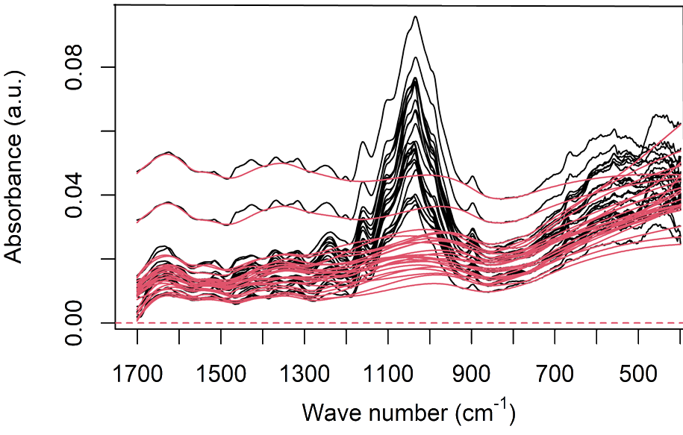
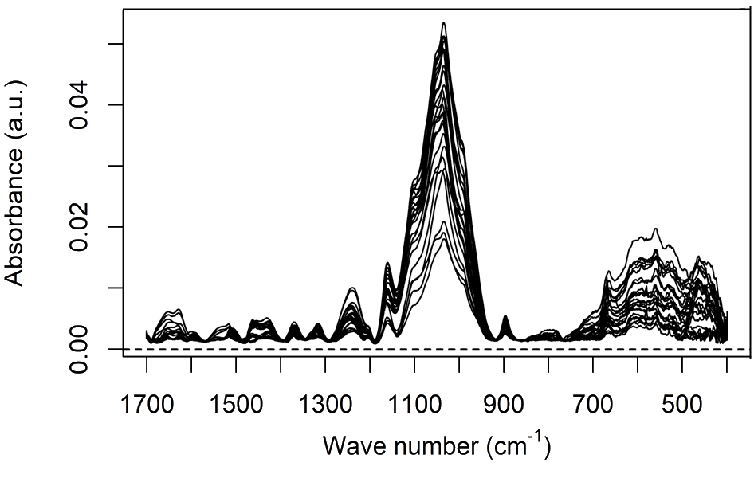
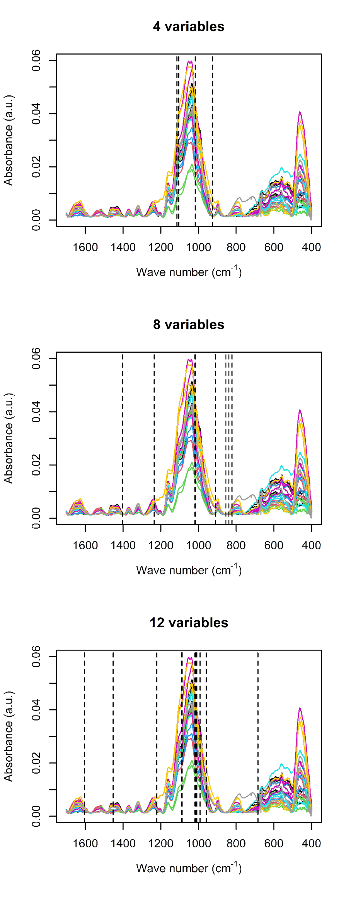
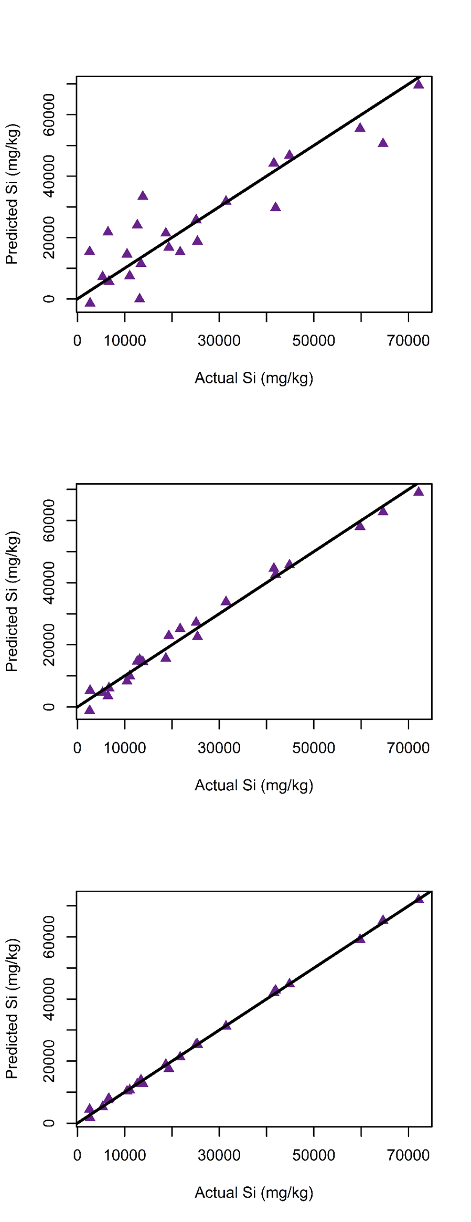

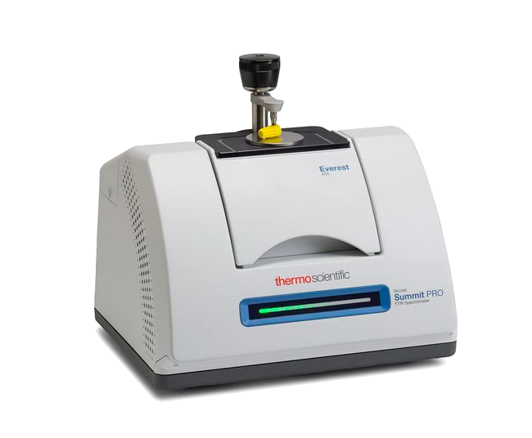
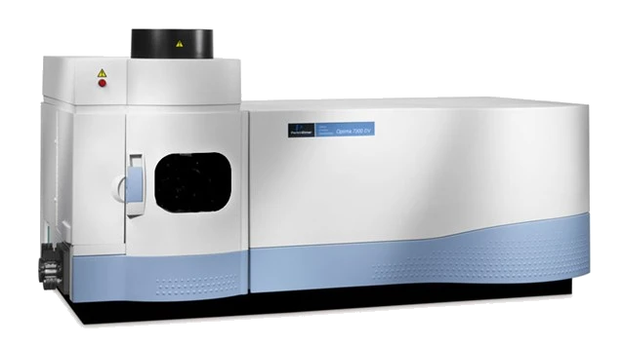

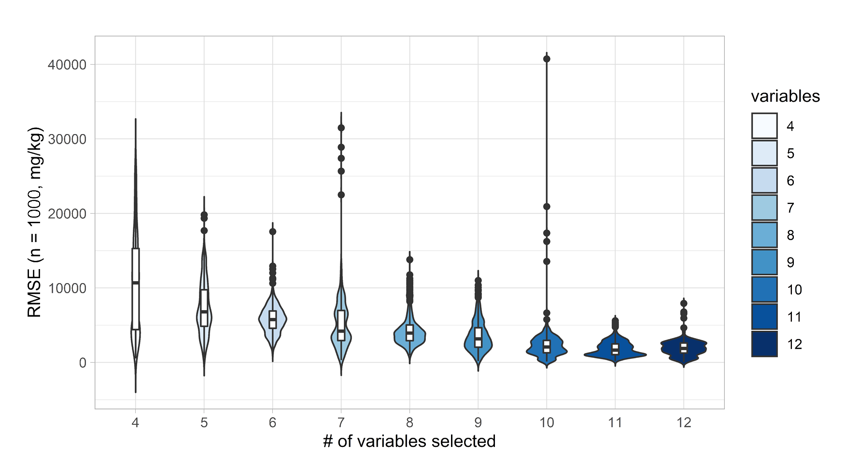
34
20
3
4
20
CONGRESO LATINOAMERICANO DE QUÍMICA
CARTAGENA DE INDIAS - COLOMBIA
CARTAGENA DE INDIAS - COLOMBIA
Determination of Silicon in Wheat Leaves with ATR-FTIR and Chemometrics
Andrés Beltrán^{1*}; Andrés Cabrera¹, Yohanna Cabrera²
¹ Departamento de Química, Facultad de Ciencias, Universidad Nacional de Colombia, Bogotá (Colombia)
² Department of Geosciences and Natural Resource Management Forest, Nature and Biomass, university of Copenhagen (Dinamarca)
Introduction
Because of the importance of crops such as wheat, barley, rice, and other grasses that accumulate Si, understanding the relationship between this element and plant science is the focus of numerous scientific efforts. Si quantification is a difficult and costly task, and destructive wet chemistry methods are commonly used. With the recent development of chemometric tools, analysis of silicon in complex matrices have has been proved feasible.
Methods
Three groups of wheat plants were cultivated using both greenhouse and controlled growing chambers in hydroponic beds. These groups were different by their silicon supply, which was through NaSiO3. Samples from the leaves of plants from all three groups were analyzed using ATR-FTIR, spectra were pre-processed by calculating the mean of three samples and performing a baseline correction.
*afbeltranr@unal.edu.co
Results
Baseline correction
Figure 1: Raw mean ATR-FTIR spectra of wheat leaves (a) rubberband baselines and spectra (b) corrected spectra (c)
4 variables
R ²_{adj} = 0.7823
F _{p-val} = 1.51e-06
8 variables
R ²_{adj} = 0.9782
Variable selection and modelling
p
Greenhouse
Experiment
Spectra acquisition
F _{p-val} = 1.14e-11
12 variables
R ²_{adj} = 0.9965
Data Analysis
ICP OES Si measurement
Preprocessing
Modelling
Prediction
validation
Absorbance (a.u.)
Predicted Si (mg/kg)
Diagram 1: Overview flowchart showing the steps of the analysis protocol
F _{p-val} = 2.42e-12
Wave number (cm⁻¹)
Actual Si (mg/kg)
start
Figure 2: Spectra and variables selected by a genetic algorithm (left) calibration lines of predicted Si content vs ICP-OES measurements (right)
Generate initial population and evaluate each chromosome (set gen = 1)
Selection
Cross- validation
gen = gen +1
crossover
mutation
Yes
Evaluate newly formed chromosomes
Is
R(gen) < R(max.gen) ?
Figure 3: Cross validated error of prediction vs model complexity 100 iterations of 10 folds
No
Conclusion
Silicon quantification in a complex vegetal matrix such as wheat leaves was possible using ATR-FTIR and chemometrics. The models presented homoscedasticity (normal residuals around zero), significance (ANOVA, p-values), and good performance in prediction (CVRMSE < 1% wt.)
stop
Diagram 2: Genetic algorithm for variable selection
References
[1] Chen, H., Ferrari, C., Angiuli, M., Yao, J., Raspi, C., & Bramanti, E. (2010). Qualitative and quantitative analysis of wood samples by Fourier transform infrared spectroscopy and multivariate analysis. Carbohydrate polymers, 82(3), 772-778.
[2] Varmuza, K., & Filzmoser, P. Introduction to multivariate statistical analysis in chemometrics. CRC press, 2016.
34
20
3
4
20
CONGRESO LATINOAMERICANO DE QUÍMICA
CARTAGENA DE INDIAS - COLOMBIA
CARTAGENA DE INDIAS - COLOMBIA

